Slide 1
Javascript Monday
a

Slide 2
Where I got all the material I used
https://developer.mozilla.org/en-US/
MDN Web Docs, previously Mozilla Developer Network and formerly Mozilla Developer Center, is a documentation repository and learning resource for web developers used by Mozilla, Microsoft, Google, and Samsung

Slide 3
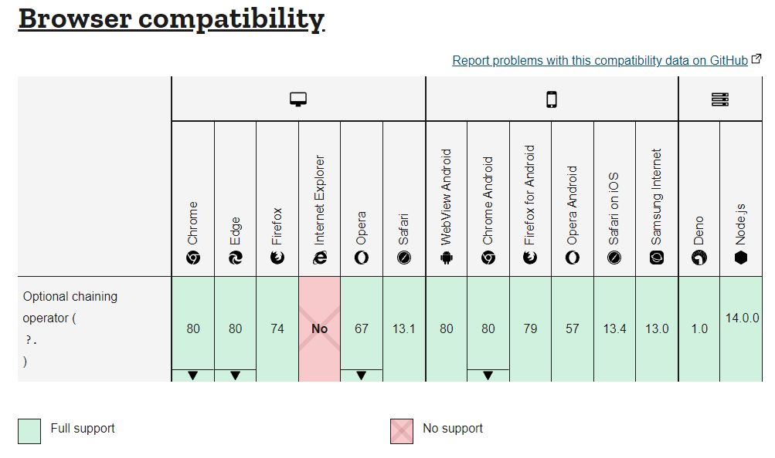
Something nice you should know

